Slide 1
Types of Inheritance
Week 7 Lec 1 & 2

Slide 2
Types of Inheritance
Single Inheritance.
Multilevel Inheritance.
Multiple Inheritance.
Hierarchical Inheritance.
Hybrid Inheritance.

Slide 3
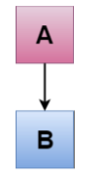
Single Inheritance
Single inheritance is defined as the inheritance in which a derived class is inherited from the only one base class. i.e. one sub class is inherited by one base class only.

Slide 4
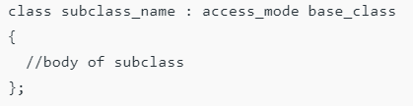
Syntax:

Slide 5
Single Level Inheritance Example: Inheriting Fields
#include <iostream>
using namespace std;
class Account {
public:
float salary = 60000; };
class Programmer: public Account {
public:
float bonus = 5000; };
int main(void) {
Programmer p1;
cout<<"Salary: "<<p1.salary<<endl;
cout<<"Bonus : "<<p1.bonus<<endl;
return 0; }

Slide 6
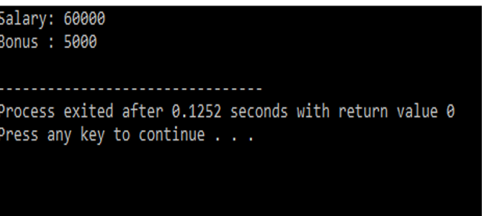
Output

Slide 7
OUTPUT?
#include <iostream>
using namespace std;
class Account {
public:
float salary = 60000; };
class Programmer: public Account {
public:
float bonus = 5000; };
int main(void) {
Account a1;
cout<<"Salary: "<<a1.salary<<endl;
cout<<"Bonus : "<<a1.bonus<<endl;
return 0; }

Slide 8
ERROR
#include <iostream>
using namespace std;
class Account {
public:
float salary = 60000; };
class Programmer: public Account {
public:
float bonus = 5000; };
int main(void) {
Account a1;
cout<<"Salary: "<<a1.salary<<endl;
cout<<"Bonus : "<<a1.bonus<<endl; //[Error] 'class Account' has no member named 'bonus'
return 0; }

Slide 9
C++ Single Level Inheritance Example: Inheriting Methods
#include <iostream>
using namespace std;
class Animal {
public:
void eat() {
cout<<"Eating..."<<endl;
}
};

Slide 10
C++ Single Level Inheritance Example: Inheriting Methods
class Dog: public Animal {
public:
void bark(){
cout<<"Barking..."; } };
int main(void) {
Dog d1;
d1.eat();
d1.bark();
return 0;
}

Slide 11
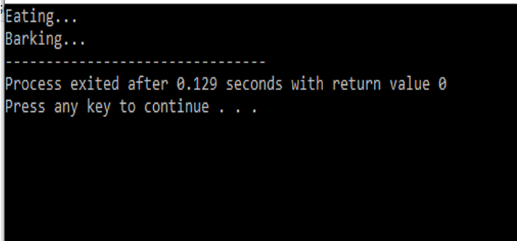
Output

Slide 12

Multilevel Inheritance
Multilevel inheritance is a process of deriving a class from another derived class.

Slide 13
Multilevel Inheritance
When one class inherits another class which is further inherited by another class, it is known as multi level inheritance in C++. Inheritance is transitive so the last derived class acquires all the members of all its base classes.

Slide 14
MULTI LEVEL Inheritance Example
class electronicDevice
{
public:
// constructor of the base class 1
electronicDevice()
{
cout << "I am an electronic device.\n\n";
}
};
// class_B inheriting class_A
class Computer: public electronicDevice
{
public:
// constructor of the base class 2
Computer()
{
cout << "I am a computer.\n\n";
}
};

Slide 15
// class_C inheriting class_B
class Linux_based : public Computer
{
public:
// constructor of the derived class
Linux_based()
{
cout << "I run on Linux.\n\n";;
}
};
int main()
{
// create object of the derived class
Linux_based obj; // constructor of base class 1,
// base class 2, derived class will be called
return 0;
}

Slide 16
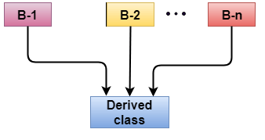
Multiple Inheritance
Multiple inheritance is the process of deriving a new class that inherits the attributes from two or more classes.

Slide 17
Syntax of the Derived class:
class D : visibility B-1, visibility B-2
{
// Body of the class;
}
Here, the number of base classes will be separated by a comma (‘, ‘) and access mode for every base class must be specified.

Slide 18
Multiple Inheritance Example
class A {
protected:
int a;
public:
void get_a(int n) {
a = n;} };
class B {
protected:
int b;
public:
void get_b(int n) {
b = n; } };

Slide 19
Multiple Inheritance Example
class C : public A,public B {
public:
void display() {
cout << "The value of a is : " <<a<< endl;
cout << "The value of b is : " <<b<< endl;
cout<<"Addition of a and b is : "<<a+b; } };
int main() {
C c;
c.get_a(10);
c.get_b(20);
c.display();
return 0;
}

Slide 20
Ambiguity Resolution in Inheritance
Ambiguity can be occurred in using the multiple inheritance when a function with the same name occurs in more than one base class.

Slide 21
Ambiguity Resolution in Inheritance
#include <iostream>
using namespace std;
class A {
public:
void display() {
cout << "Class A" << std::endl; } };
class B {
public:
void display() {
cout << "Class B" << std::endl; } };

Slide 22
Ambiguity Resolution in Inheritance
class C : public A, public B {
public:
void view() {
display(); } };
int main() {
C c;
c.view();
return 0; }

Slide 23
OUTPUT
[Error] reference to 'display' is ambiguous
The above issue can be resolved by using the class resolution operator with the function. In the above example, the derived class code can be rewritten as:

Slide 24
class C : public A, public B
{
public: void view()
{
A :: display(); // Calling the display() function of class A.
B :: display(); // Calling the display() function of class B.
}
};

Slide 25
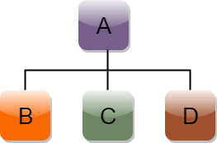
Hierarchical Inheritance
Hierarchical inheritance is defined as the process of deriving more than one class from a base class.

Slide 26
Syntax of Hierarchical inheritance:
class A
{
// body of the class A.
}
class B : public A
{
// body of class B.
}
class C : public A
{
// body of class C.
}
class D : public A
{
// body of class D.
}

Slide 27
Example
#include <iostream>
using namespace std;
class Shape // Declaration of base class.
{ public:
int a;
int b;
void get_data(int n,int m) {
a= n;
b = m; }
};

Slide 28
Example
class Rectangle : public Shape{ // inheriting Shape class
public:
int rect_area() {
int result = a*b;
return result; } };
class Triangle : public Shape { // inheriting Shape class
public:
int triangle_area() {
float result = 0.5*a*b;
return result; } };

Slide 29
Example
int main() {
Rectangle r;
Triangle t;
int length,breadth,base,height;
cin>>length>>breadth;
r.get_data(length,breadth);
int m = r.rect_area();
cout << "Area of the rectangle is : " <<m<< std::endl;
cin>>base>>height;
t.get_data(base,height);
float n = t.triangle_area();
cout <<"Area of the triangle is : " << n<<std::endl;
return 0; }

Slide 30
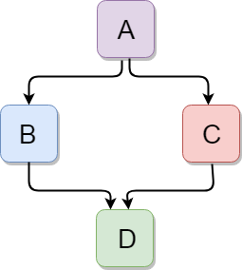
C++ Hybrid Inheritance
Hybrid inheritance is a combination of more than one type of inheritance.

Slide 31
Example
#include <iostream>
using namespace std;
class A {
protected:
int a;
public:
void get_a() {
cout << "Enter the value of 'a' : " << std::endl;
cin>>a; } };

Slide 32
Example
class B : public A {
protected:
int b;
public:
void get_b() {
cout << "Enter the value of 'b' : " << endl;
cin>>b; } };

Slide 33
Example
class C : public A {
protected:
int c;
public:
void get_c() {
cout << "Enter the value of c is : " << endl;
cin>>c; } };

Slide 34
Example
class D : public B, public C {
protected:
int d;
public:
void mul() {
get_a();
get_b();
get_c();
cout << "Multiplication of a,b,c is : " <<a*b*c<< endl; } };

Slide 35
Example
int main() {
D d;
d.mul();
return 0; }

Slide 36
When static members are inherited, are they static for the entire hierarchy, or just that class?
class SomeClass{
public:
SomeClass() {total++;}
static int total;
void Print(string n) { cout << n << ".total = " << total << endl; }};
int SomeClass::total = 0;
class SomeDerivedClass: public SomeClass{
public:
SomeDerivedClass() {total++;}};
int main(int argc, char ** argv){
SomeClass A;
SomeClass B;
SomeDerivedClass C;
A.Print("A");
B.Print("B");
C.Print("C");
return 0;}

Slide 37
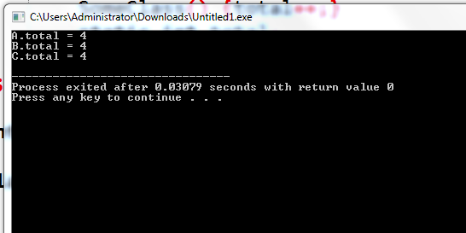

Slide 38
Task
Create a class named MusicalComposition that contains fields for title, composer, and year written(attribute only accessible by its subclass). Include a setter function that requires all three values and an appropriate display function. The child class NationalAnthem contains an additional field that holds the name of the anthem’s nation. The child class setter requires a value for this additional field. The child class also contains a display function. Write a main() function that instantiates object of subclass and call both display functions .

Slide 39
Solution
#include <iostream>
#include <String>
#include<ios> //used to get stream size
#include<limits> //used to get numeric limits
using namespace std;
class MusicComposition {
protected:
string title,compose;
int year;
public:
void setA(){
cout << "enter title"<< endl;
getline(cin ,title);
cout << "composer"<< endl;
getline(cin ,compose);
cout << "enter year"<< endl;
cin >> year;
}

Slide 40
Solution
void display() {
cout << title << compose << year <<endl; } };
class NationalAnthem : public MusicComposition{
public:
string name;
void setB(){
cout << "enter name"<< endl;
cin.ignore(); //clear buffer before taking new line
getline(cin ,name);
}
void display() {
cout << name << endl; } };

Slide 41
Solution
int main() {
NationalAnthem n;
n.setA() ;
n.setB();
n.MusicComposition::display();
n.display();
return 0; }

Slide 42
Constructors and Destructors in Derived Classes
When we construct a derived class object, the base object must be created first. If we do not specify any base-constructor, it calls a default base-constructor. This is because the base-constructor does initialization of derived object's the inherited base-class member. The members of derived object are initialized by the derived-constructor.
Invocation of constructors and destructors depends on the type of inheritance being implemented.

Slide 43
Constructors and Destructors in Derived Classes
Instantiating a derived-class object begins a chain of constructor calls in which the derived-class constructor, before performing its own tasks, invokes its direct base class’s constructor either explicitly (via a base-class member initializer) or implicitly (calling the base class’s default constructor). Similarly, if the base class is derived from another class, the base-class constructor is required to invoke the constructor of the next class up in the hierarchy, and so on. The last constructor called in this chain is the constructor of the class at the base of the hierarchy, whose body actually finishes executing first. The original derived-class constructor’s body finishes executing last. Each base-class constructor initializes the base-class data members that derived-class object inherits.

Slide 44
Constructor and destructor in single inheritance
#include <iostream>
using namespace std;
class A{
public:
A() { cout << "A()" << endl; }};
class B : public A{
public:
B() { cout << "B()" << endl; }}; // BY DEFAULT B() : A()
int main(){
B b;
return 0;
}

Slide 45
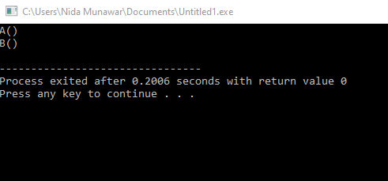
Constructor and destructor in single inheritance
Remember, a derived-class constructor always calls a base-class constructor. The base-class object should be constructed before the code enters the body of the derived-class constructor.

Slide 46
Important points
Whenever the derived class’s default constructor is called, the base class’s default constructor is called automatically.
To call the parameterized constructor of base class inside the parameterized constructor of sub class, we have to mention it explicitly.
The parameterized constructor of base class can be called in default constructor of sub class

Slide 47
Example
#include <iostream>
using namespace std;
class A{
protected:
int ia;
public:
A()
{ cout << "A()" << endl; }};
class B : public A{
int ib;
public:
B(int n) : ib(n) { cout << "B()" << endl; }};
int main(){
B b(2);
return 0;}

Slide 48
Example
#include <iostream>
using namespace std;
class A{
protected:
int ia;
public:
A(int n) : ia(n) { cout << "A()" << endl; }};
class B : public A{
int ib;
public:
B(int n) : ib(n) { cout << "B()" << endl; }}; //[Error] no matching function for call to 'A::A()'
int main(){
B b(2);
return 0;}

Slide 49
Example
#include <iostream>
using namespace std;
class A{
protected:
int ia;
public:
A(int n) : ia(n) { cout << "A()" << endl; }};
class B : public A{
int ib;
public:
B(int n) : ib(n) { cout << "B()" << endl; }}; //[Error] no matching function for call to 'A::A()’
int main(){
A a (3);
B b(2);
return 0;}

Slide 50
The parameterized constructor of base class can be called in default constructor of sub class
#include <iostream>
using namespace std;
class A{
protected:
int ia;
public:
A(int n) : ia(n) { cout << "A()" << endl; }};
class B : public A{
int ib;
public:
B() : A(3) { cout << "B()" << endl; }};
int main(){
B b;
return 0;}

Slide 51
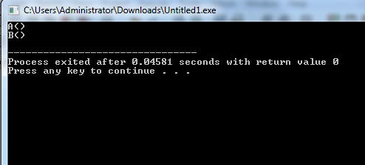

Slide 52
Parametrized Base Constructor
If we need to initialize inherited the base-class member with different value from a default value, we can use base-class constructor in the initializer list of the derived-class constructor
Derived class constructor(arg1,arg2) : base(arg1){
derived= arg2;} // order of arguments doesn't matter
OR
Derived class constructor(arg1,arg2) : base(arg1) , derived(arg2){}
OR
Derived class constructor(arg1) : base(any value) , derived(arg1){}

Slide 53
Parametrized Base Constructor
#include <iostream>
using namespace std;
class A{
public:
A(int n = 1) : ia(n)
{ cout << "A() ia = " << ia << endl; }
protected:
int ia;};
class B : public A{
int ib;
public:
B(int n , int a) : ib(n), A(a)
{ cout << "B()" << endl; } };
int main(){
B b(2 ,4);
return 0;}

Slide 54
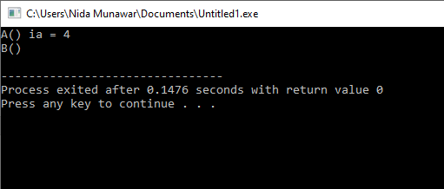
Parametrized Base Constructor

Slide 55
Parametrized Base Constructor
#include <iostream>
using namespace std;
class A{
public:
A(int n) : ia(n)
{ cout << "A() ia = " << ia << endl; }
protected:
int ia;};
class B : public A{
int ib;
public:
B(int n) : ib(n), A(n)
{ cout << "B() ib =" << ib << endl; } };
int main(){
B b(2);
return 0;}

Slide 56
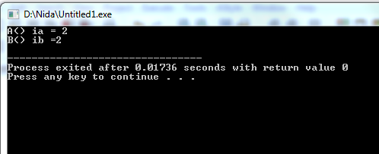
Parametrized Base Constructor

Slide 57
Constructor and destructor in Hierarchical inheritance
#include <iostream>
using namespace std;
class A{
public:
A() { cout << "A()" << endl; }};
class B : public A{
public:
B() { cout << "B()" << endl; } };
class C : public A{
public:
C() { cout << "C()" << endl; } };
int main(){
B b;
C c;
return 0;}

Slide 58
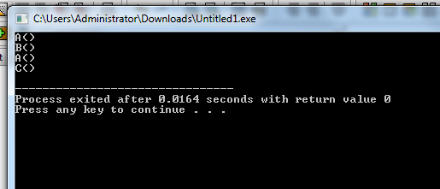

Slide 59
Constructor and destructor in multiple inheritance
Constructors from all base class are invoked first and the derived class constructor is called.
Order of constructor invocation depends on the order of how the base is inherited.
For example:
class C :public A , public B

Slide 60
Constructor and destructor in multiple inheritance
Here, A is inherited first, so the constructor of class A is called first and then constructor of class B is called next.
However, the destructor of derived class is called first and then destructor of the base class which is mentioned in the derived class declaration is called from last towards first in sequentially.

Slide 61
Syntax
Derived class constructor(arg1,arg2,arg3) : base1(arg1) , base2(arg2){
derived= arg3;}
OR
Derived class constructor(arg1,arg2,arg3) : base1(arg1) , base2(arg2), derived(arg3){}

Slide 62
Constructor and destructor in multiple inheritance
class A{
public: A(int a) { cout << "A()" << a << endl; }};
class B{
public: B(int b ){ cout << "B()" << b << endl; } };
class C :public A , public B{
public:
int m;
C(int x, int y, int z): A(x) , B(y) ,m(z){
cout<< "C()" << m << endl;}};
int main(){
C c(2,4,6);
return 0;}

Slide 63
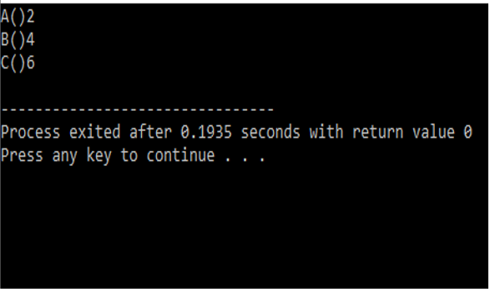
Constructor and destructor in multiple inheritance

Slide 64
Constructor and destructor in multi level inheritance
class A{
public:
A() { cout << "A()" << endl; }};
class B : public A{
public:
B() { cout << "B()" << endl; } };
class C : public B{
public:
C() { cout << "C()" << endl; } };
int main(){
C c;
return 0;}

Slide 65
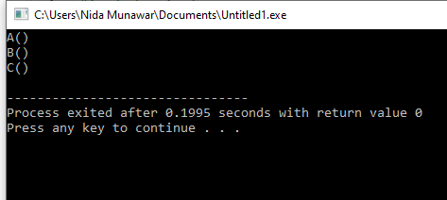
Constructor and destructor in multi level inheritance

Slide 66
You can not directly call indirect parent(A) constructor in C
class A{
public:
A(int a) { cout << "A()" << endl; }};
class B : public A{
public:
B(int b) :A(b){ cout << "B()" << endl; } };
class C : public B{
public:
C():B(3) { cout << "C()" << endl; } };
int main(){
C c;
return 0;}

Slide 67
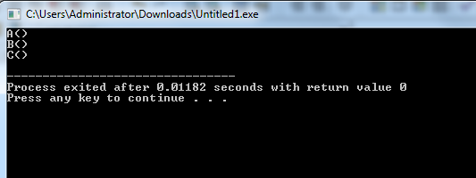

Slide 68
#include <iostream>
using namespace std;
class A{
public:
A(int a) { cout << "A()" << endl; }};
class B : public A{
public:
B(){ cout << "B()" << endl; } };
class C : public B{
public:
C():A(3) { cout << "C()" << endl; } }; //error
int main(){
C c;
return 0;}

Slide 69
Task
Create a class named A include a constructor that accepts one parameter(any type) , create another class named B that inherits from A also include a constructor that accepts one parameter(any type) , create a class named C that inherits from B having a constructor that accepts one parameter now initialize all base class constructors through the child classes
Remember if the base class is derived from another class, the base-class constructor is required to invoke the constructor of the next class up in the hierarchy

Slide 70
Solution
#include <iostream>
using namespace std;
class A{
public:
A(int a=1) { cout << "A()" << a << endl; }};
class B : public A{
public:
B(int b , int valA ):A(valA) { cout << "B()" << b << endl; } };
class C : public B{
public:
C(int c ,int valB):B(valB ,6) { cout << "C()" <<c << endl; } };
int main(){
C c(2,4);
return 0;}

Slide 71
Solution
#include <iostream>
using namespace std;
class A{
public:
A(int a=1) { cout << "A()" << a << endl; }};
class B : public A{
public:
B(int b , int valA ):A(valA) { cout << "B()" << b << endl; } };
class C : public B{
public:
C(int c ,int valB, int ia):B(valB ,ia) { cout << "C()" <<c << endl; } };
int main(){
C c(2,4,6);
return 0;}

Slide 72
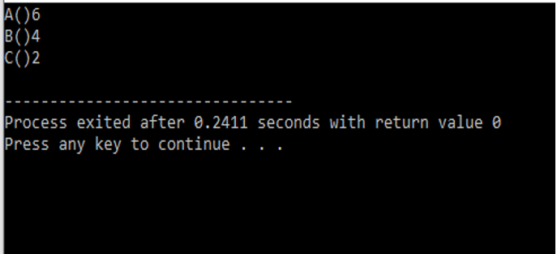
Solution

Slide 73
Case study
Create an Investment class that contains fields to hold the initial value of an investment, the current value,the profit (calculated as the difference between current value and initial value), and the percent profit (the profit divided by the initial value). Include a constructor that requires initial and current values and a display function. Create a House class that includes fields for street address and square feet, a constructor that requires values for both fields, and a display function. Create a HouseThatIsAnInvestment class that inherits from Investment and House. It includes a constructor and a display function that calls the display functions of the parents. Write a main()function that declares a HouseThatIsAnInvestment and displays its values.

